Slide 1

Data Analytics with Python
x= “Welcome everybody!”
print(x)
Output:
Welcome everybody!

Slide 2
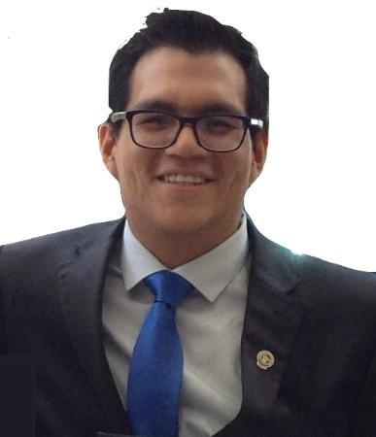
Instructor: Oscar Atanacio
Master in Computer Science
Data Engineer @Schneider Electric
Your Professor

Slide 3
On Keys to Success...

Slide 4

Don’t Be This Guy...

Slide 5

This Should Be You.

Slide 6


Course Structure:
Introduction to Python Data Analytics
Patterns Recognition and Machine Learning
Pandas for Data Analysis
Matplotlib Visualizations
- Final Project Day

Slide 7

Let’s Get Pythonic!

Slide 8
Introduction to Data Analysis Process
Python Mini Bootcamp

Slide 9





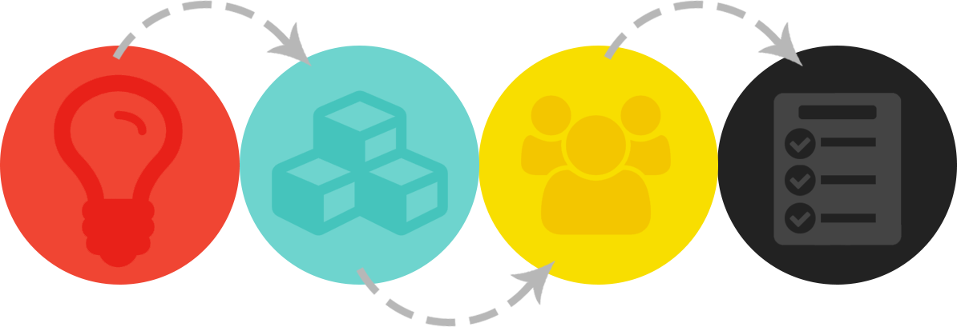
Why Data Science and Analytics?
2.
Explosive Growth in Analytic Tool (Synthesis)
1.
Explosive Growth in Digitized Data (Creation)
3.
Accelerating Search for Actionable Insight (Value)

Slide 10
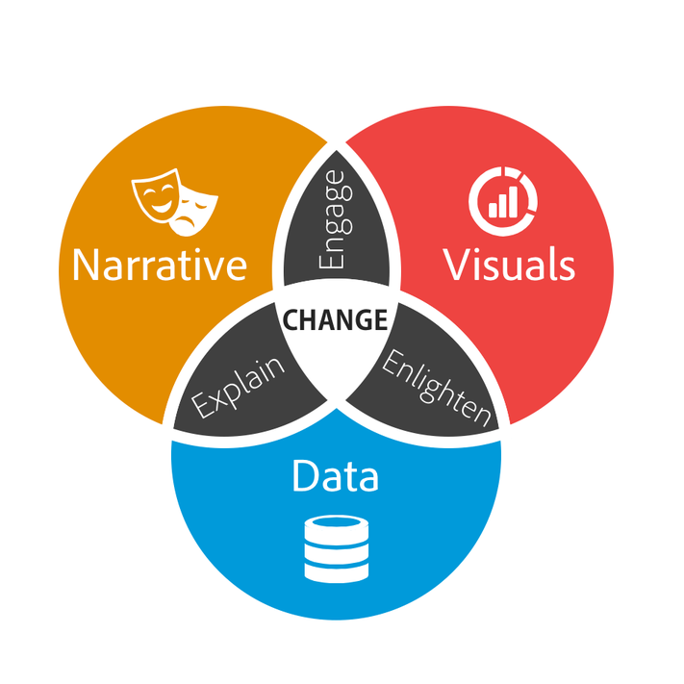

Fundamentally, data analytics is about:
storytelling
truth-telling.

Slide 11
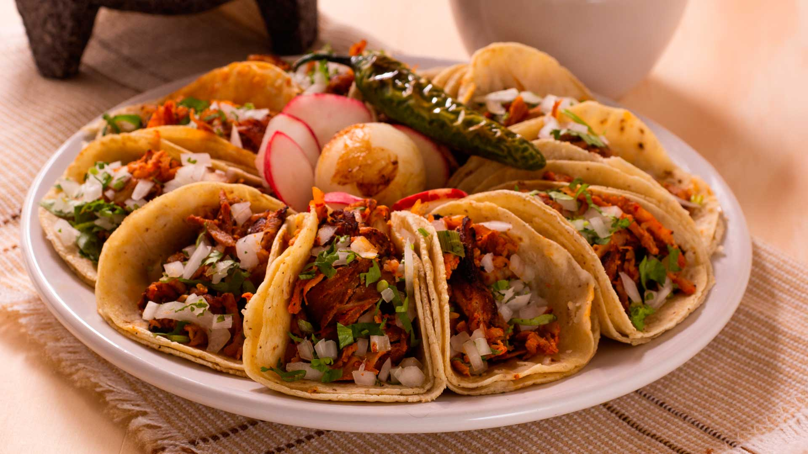
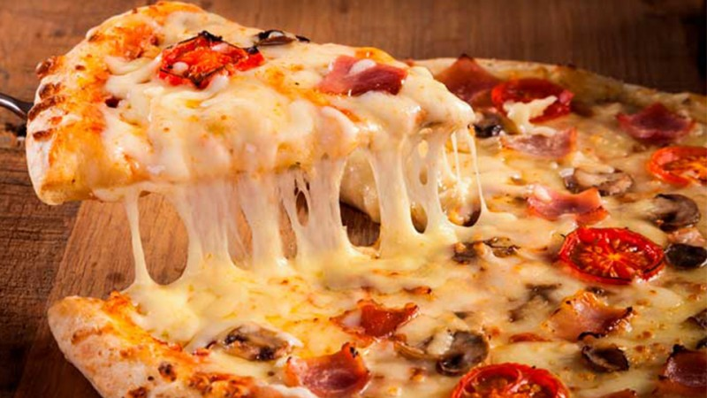
Group Activity: Analysis Process
What does Mexicans prefer tacos or pizza?

Slide 12
Group Activity: Analysis Process
With your group develop a strategy for answering this questions with as much confidence posible.
- What data will you attemp to gather?
- What relationships Will you be looking for?
- How Will you ensure your answer is most likely “true”?
Imagine you have a reduced bucket for the investigation and you only have your team.

Slide 13
Review Step 1. Decompose the “Ask”
What does Mexicans prefer tacos or pizza?
What defines a Mexican?
Do Mexican people live in the most important cities?
Are Mexicans just millenials?
How do we define prefer?
Do people prefer the foods they eat every day?
Is preference a regionalized phenomena?
Is preference objective or subjective?

Slide 14





Step 2. Identify Data Sources
Where can we get information about the Ask ?

Slide 15
Step 3. Define Strategy and Metrics
We create a blueprint for what we are targeting:
Mexicans:
We need large samples of data, from different cities.
Preference:
Number of people reviews
Ratings in yelp or maps.
Top 20 restaurants in the major cities:

Slide 16
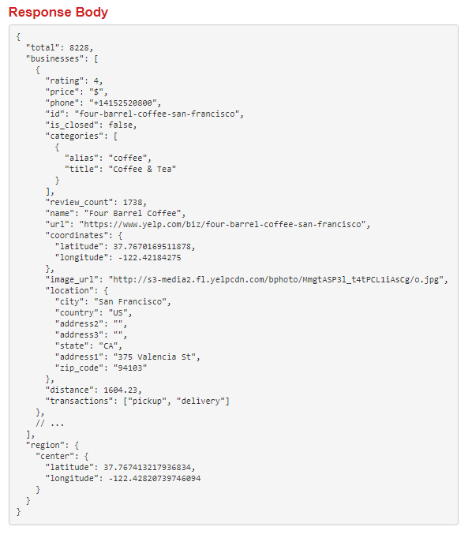
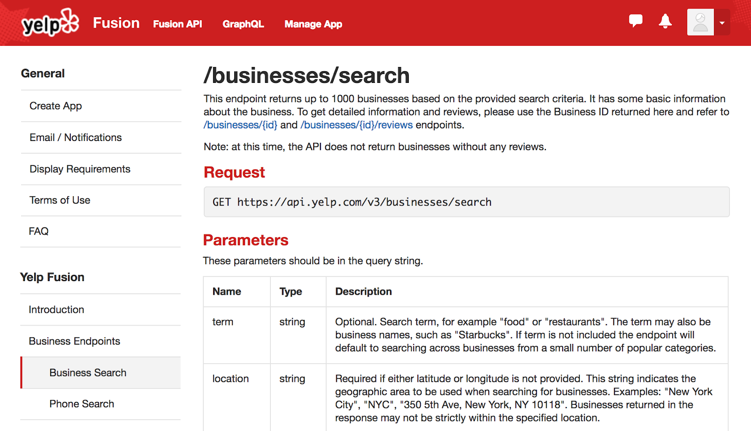
Step 4. Build a retrieval plan
- Use of automated searches (APIs)

Slide 17

Step 4. Build a retrieval plan
We can create a Python script that can ask Yelp for Random Mexican Postal codes and get the top 20 Restaurants per food type
?????

Slide 18
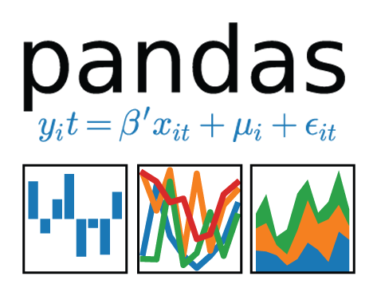

Step 5. Retrieve the Data
Zip code selection
Query to YELP
Store output in a DataFrame

Slide 19
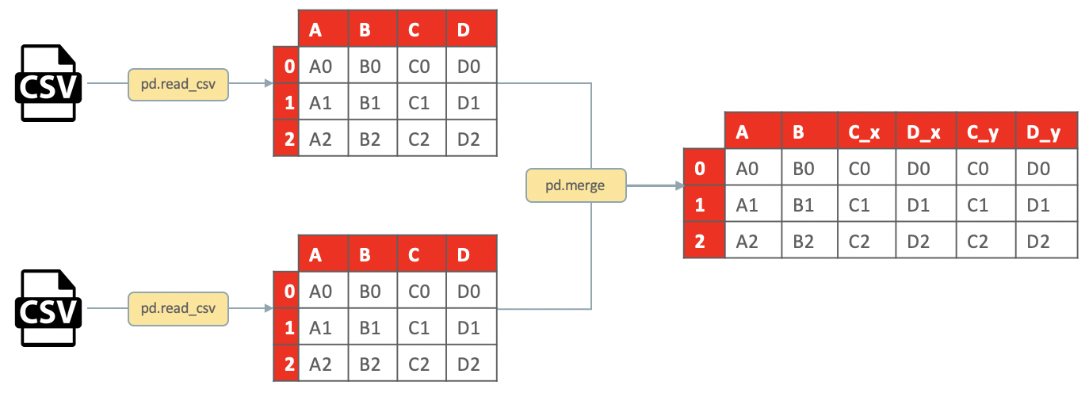
Step 6. Assemble and clean the data

Slide 20
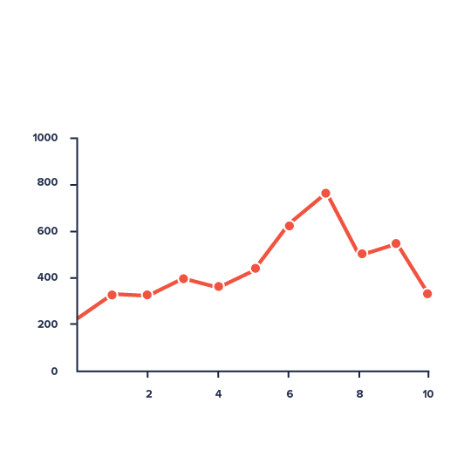
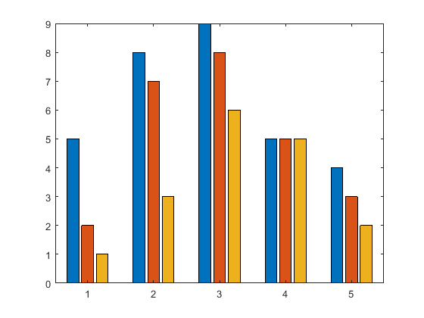

Step 7. Analyze for Trends

Slide 21
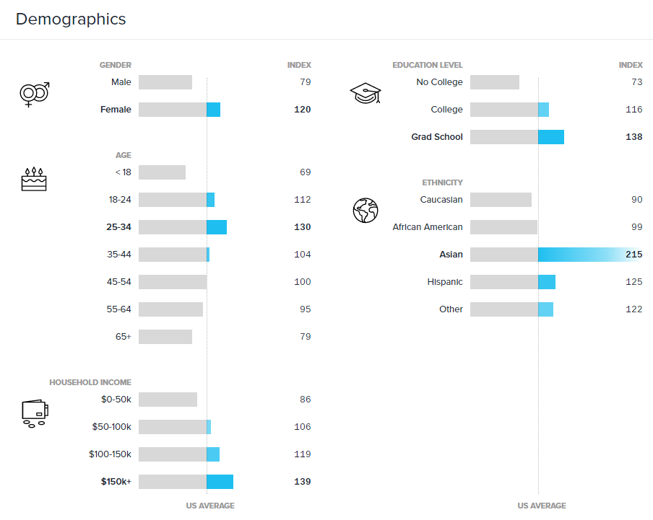
Step 8. Acknowledge Limitations

Slide 22
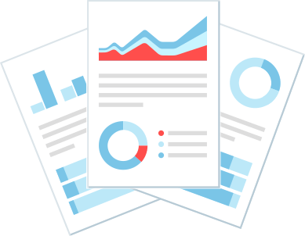

Step 9. Make the call

Slide 23
The Whole Process
Decompose the Ask
Identify Data Sources
Define Strategy and Metrics
Build Data Retrieval Plan
Retrieve the Data
Assemble and Clean
Analize for Trends
Acknowledge Limitations
Make the Call or Tell the Story

Slide 24
Programming Thinking and Python Basic
Python Mini Bootcamp

Slide 25
How Does Computers think?
Step 1
Step 2
Step 3
Step 4
To solve real world problems using the assistance of a computer we MUST break it down into a set of procedural steps.

Slide 26
Code is written procedurally
Python COde
Python code runs downwards
#Step 1: Price per item
apples = 20
bananas = 5
#Step 2 : Total to pay
total = apples + bananas
#Step 3: Run function “ask for money”
askforMoney(total)
#step4: Deliver the change
deliverChange()
- Apples and bananas are variables where we store some of data.(1)
- We can run mathematical operations with variables (2)
- Functions are used to run pieces of code with a specific purpose.
- Functioins can (3) or cannot(4) recieve variables as parameters to be used in the logic.

Slide 27
Fundamentals tolos of Programming
Programming tool
Python implementation
Conditionals: Boolean (True or False) Responses.
Iterations: For i in range(x), while x =True.
Functions: def askforpayment(total)
Variables/Arrays: a = 1 / b = [1,2,3,4,5]:
If, elif and else statements. Produces True or False depending on conditions.
For and While loops. Used for Repeating functionality depending on a variable
def functionName(parameters): contains code to be run every time we use the function name and parameters
store 1 or multiple data inside it.

Slide 28
How do you make a sandwich?
Get bread, peanut butter, and jelly from pantry.
Lay out bread on table.
Open jars of peanut butter and jelly.
Get spreading knife.
Use knife to spread peanut butter.
Use knife to spread jelly.
Combine bread to create sandwich.
Conditional and Iterative processes:
For i in range(5):
If ingredientThickness >.5:
stopSpreading()
else:
spreadMore()

Slide 29

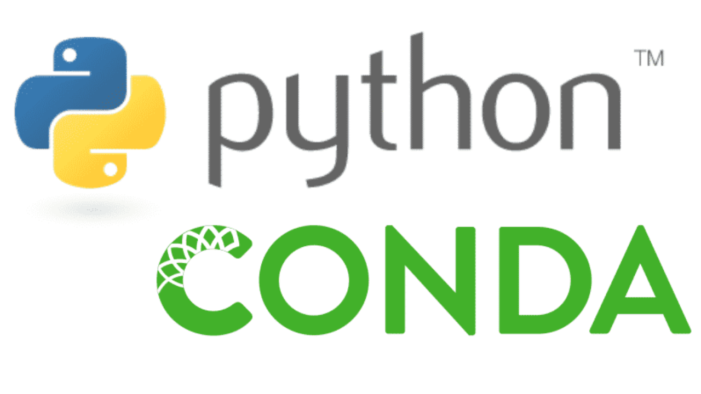

LET’S GO CODING!!!
Python Mini Bootcamp

